Slide 1

Muhammad Ali Jinnah University
Human Computer Interaction
Project Proposal
Instructions:
All content should be presented in bullets.
All questions should be answered properly.
Don’t skip any slide.

Slide 2

Project Title :
F4A
Electronic Repair

Slide 3
Group Member
Ahmed Amin (FA19-BSSE-0063) -CM
Asad Ali Abbasi (FA19-BSSE-0050) - CM
Muhammad Fahad (FA19-BSSE-0014) – BM
Muhammad Asim Anis (FA19-BSSE-0032) -BM
Ahsan Mansoori (FA19-BSSE-0013) – BM
Instructor : Dr. Shaukat Wasi

Slide 4
PROBLEM STATEMENT
The process to repair an electronic device is time consuming, high cost and have fraud risk.

Slide 5
Who are the users?
Primary users.
Shopkeeper, Customer (who need to Repair the decive).
Secondary users.
Delivery partner (3rd party).

Slide 6
What is the current user experience?
A person has to first visit the market himself to show his device to every single shopkeeper
Then find that it is repairable or not
Find good cost
Trust that shopkeeper even he don’t have any reviews
Pick his device himself

Slide 7
Why is a change needed?
Because a person has to visit market to know if his device is repairable or not
Because there are chances of fraud.
Because there are chances of paying more than the actual cost.
Because a person has to make time out of his schedule to go to market.

Slide 8
How will this change improve the situation?
The person don’t have to visit market saving time of going and picking device after repair
Can instantly know that device is repairable or not.
Bidding help a person to get better choice of cost he wants.
Reviews helps to select a better shopkeeper you can trust.
Device is taken by 3rd party riders safely from customer to shopkeeper and shopkeeper to customer
Less chances of fraud due to double verification at each step from device picking to getting device and to verify that device is working well within its guarantee’s day.

Slide 9
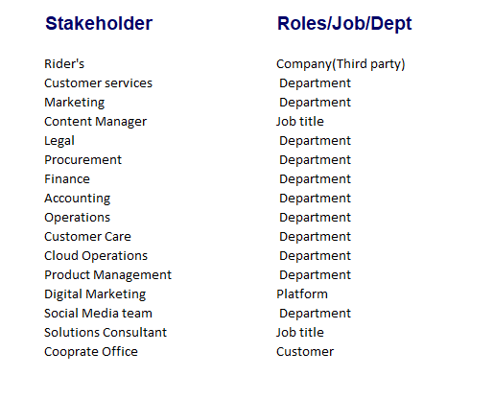
Who are the stakeholders?

Slide 10
What Inspiration Method(s) will be used?
Photojournal.
Align on your impact goals.

